Slide 1
Financial Plan Outline
Identify the forecasted revenues and expenses.
Prepare the 3-year forecast Profit or Loss statement (use the Income Statement template from video).
Prepare the cash flow statement (Cash in and cash out, review the sample in the next slide). Use the 3- year Cash Flow Projection detailed and summary view.
Present your investment or the cost in the development of the application/project (refer to sample in slide 3)
5. Compute for the Payback period.
https://www.youtube.com/watch?v=IW2qvXcrx6k
https://www.youtube.com/watch?v=1QTYghI9IrI

Slide 2
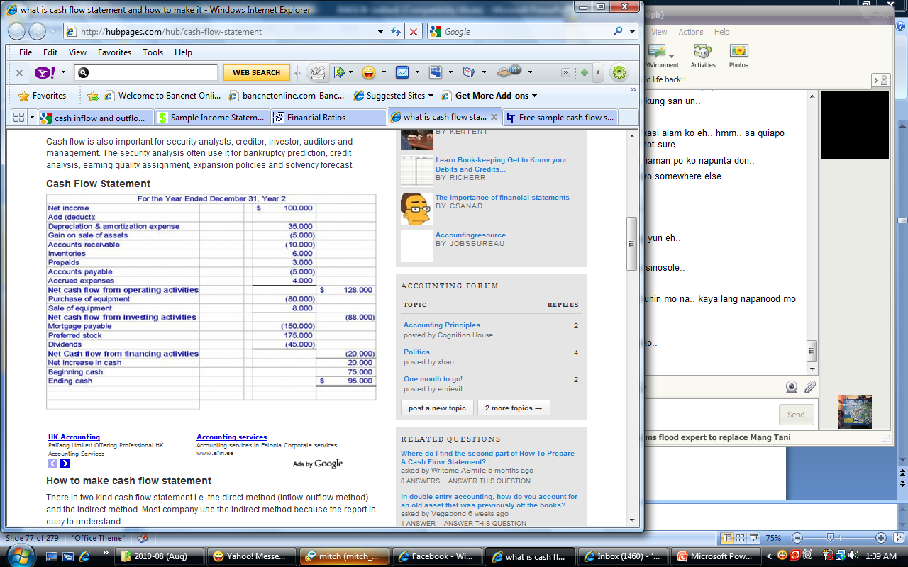
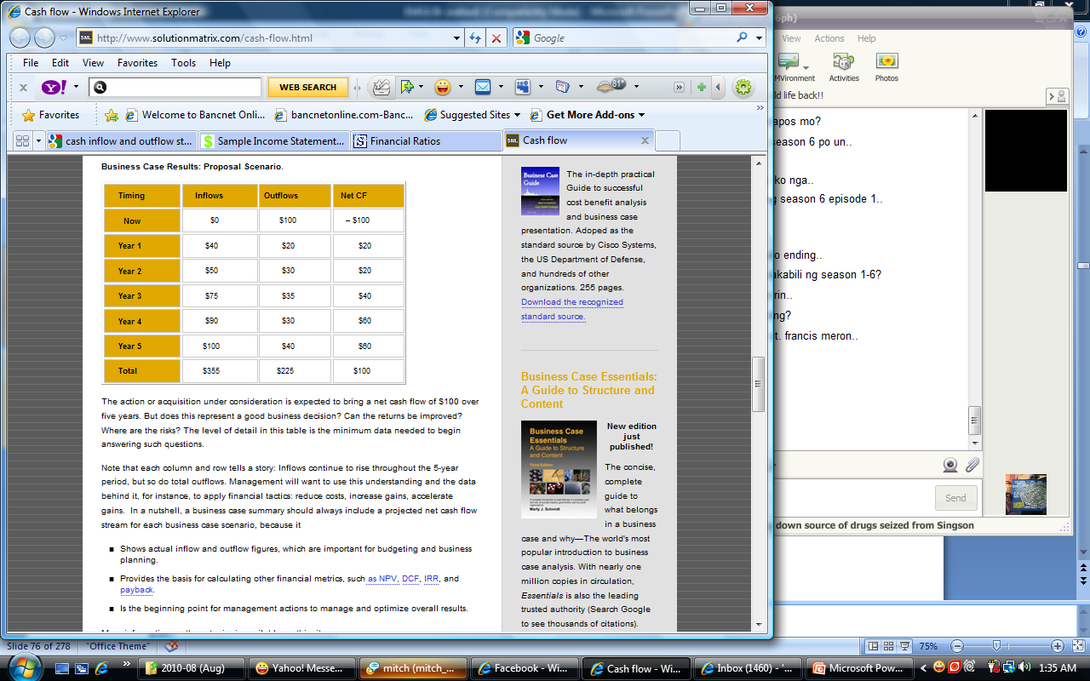

Slide 3
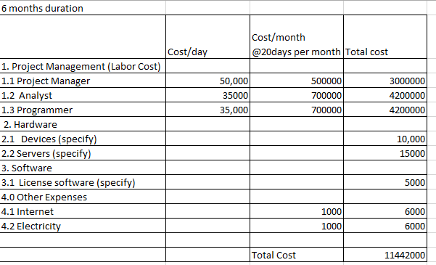
Software Development Cost

